Slide 1
Policy Gradient Methods
Dr Prashant Aparajeya

Slide 2
Back Propagation
State
- Log Probabilities x Reward
Policy Network
Action Probabilities
Log Probabilities
Best Action
Environment
Reward & New State
Policy Network :- Serves as a direct representation of a policy
(Deep) Neural Network outputs action probabilities given a state
REINFORCE algorithm uses gradient ascent for policy updates
Challenge with Policy Gradient :- High Variance from returns
Mitigation :- Design a baseline network to estimate of the expected actual return and should not introduce bias into the policy gradient

Slide 3
Policy Gradient: Motivation
In many problems, especially those with:
Continuous action spaces (e.g., robotics),
Stochastic policies (for exploration),
or non-deterministic environments,
it's hard to derive optimal actions from a value function. Policy gradient methods sidestep this by parameterizing the policy and improving it directly.

Slide 4
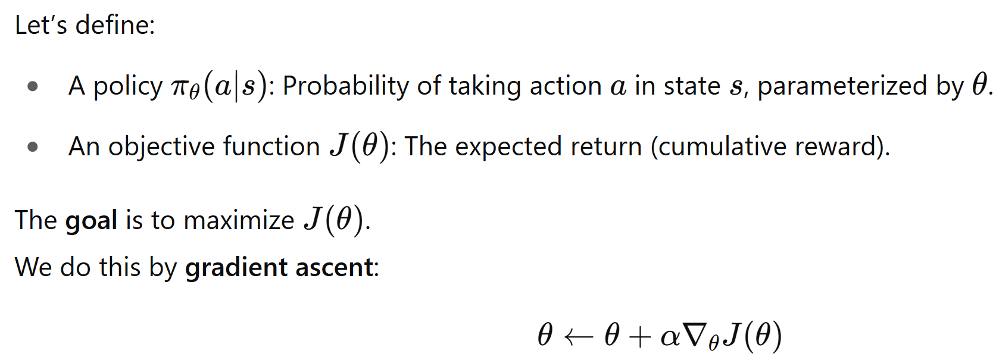
High-Level Idea

Slide 5
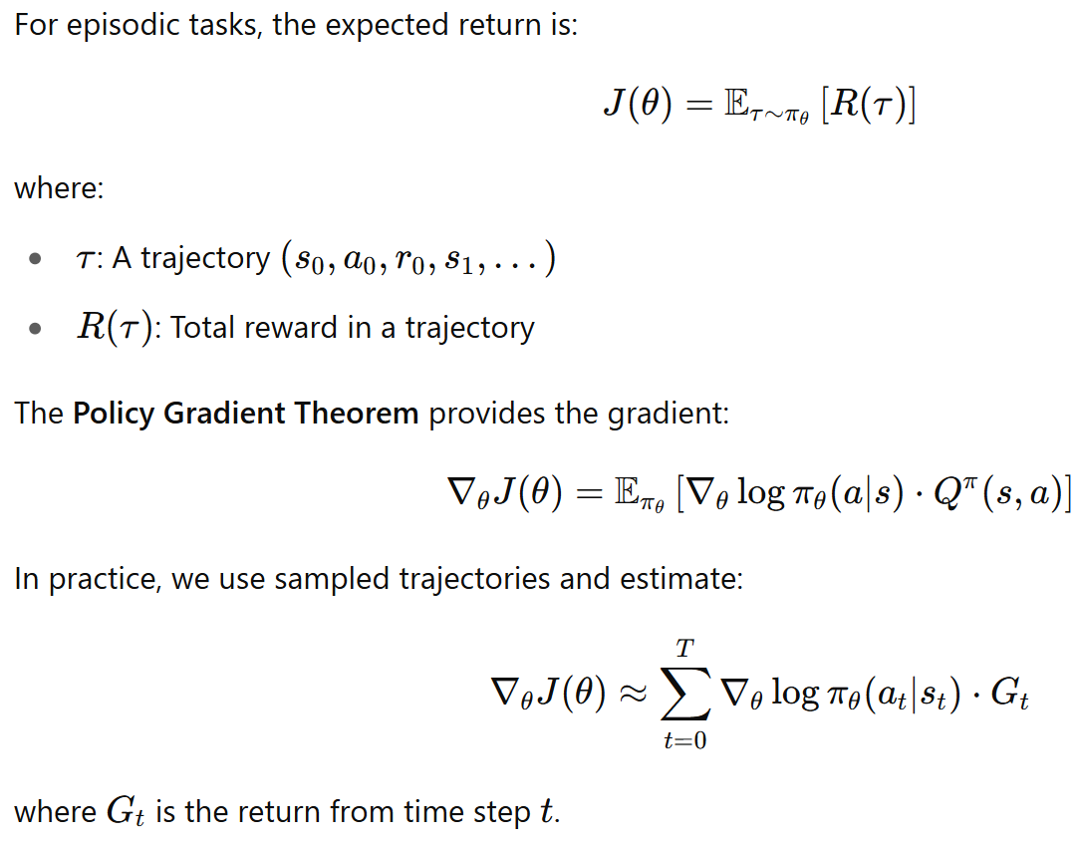
Objective Function

Slide 6

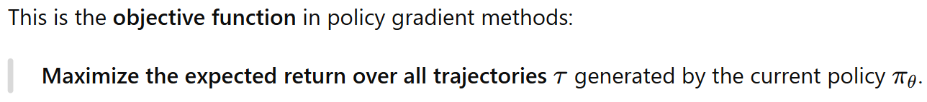

Slide 7
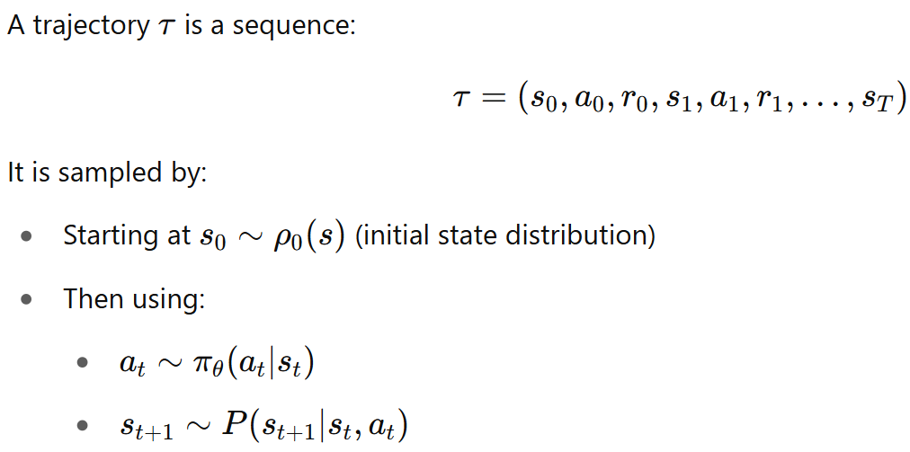
What is a trajectory τ?

Slide 8
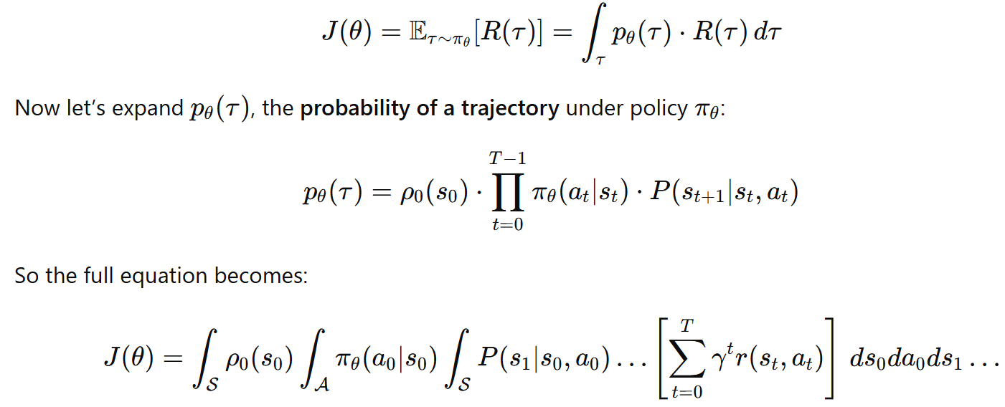
Expectation into an Integral

Slide 9
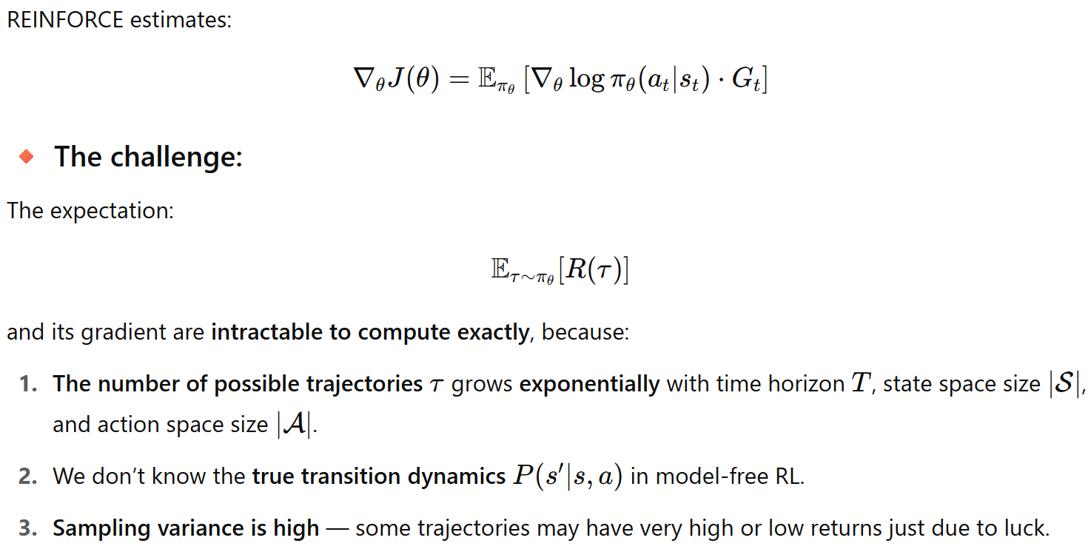
What is intractable here in REINFORCE?

Slide 10
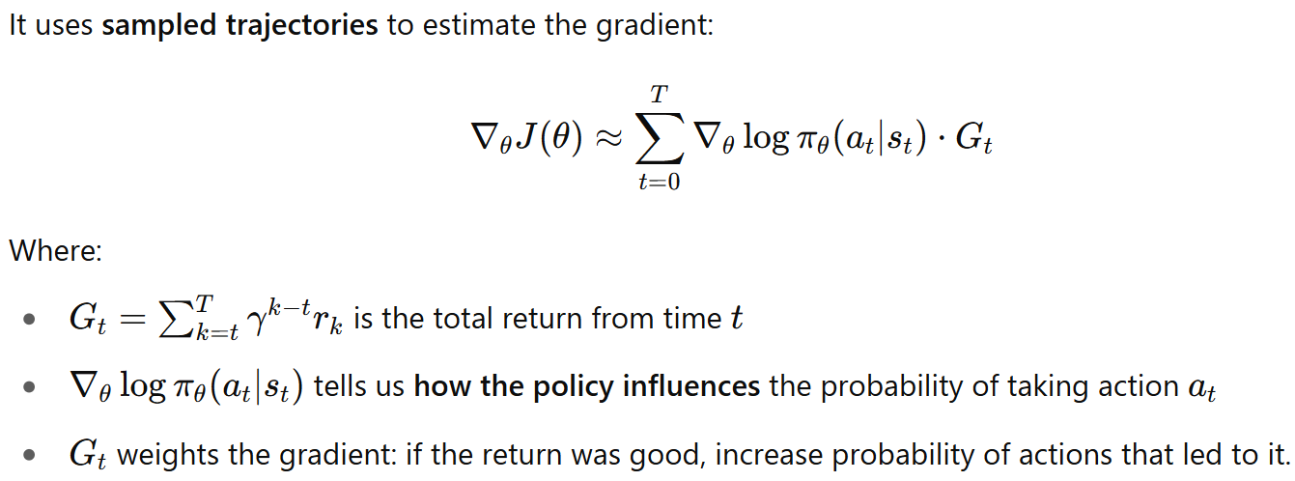
What is REINFORCE?
REINFORCE is the simplest Monte Carlo Policy Gradient method proposed by Williams (1992).

Slide 11
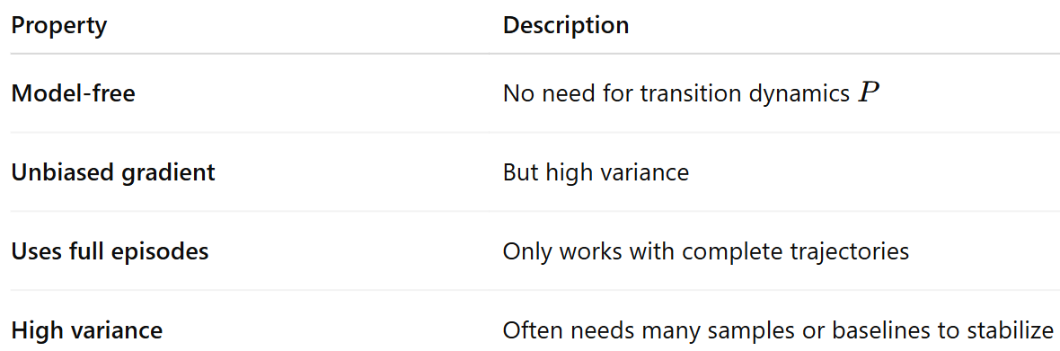
Key Properties of REINFORCE

Slide 12
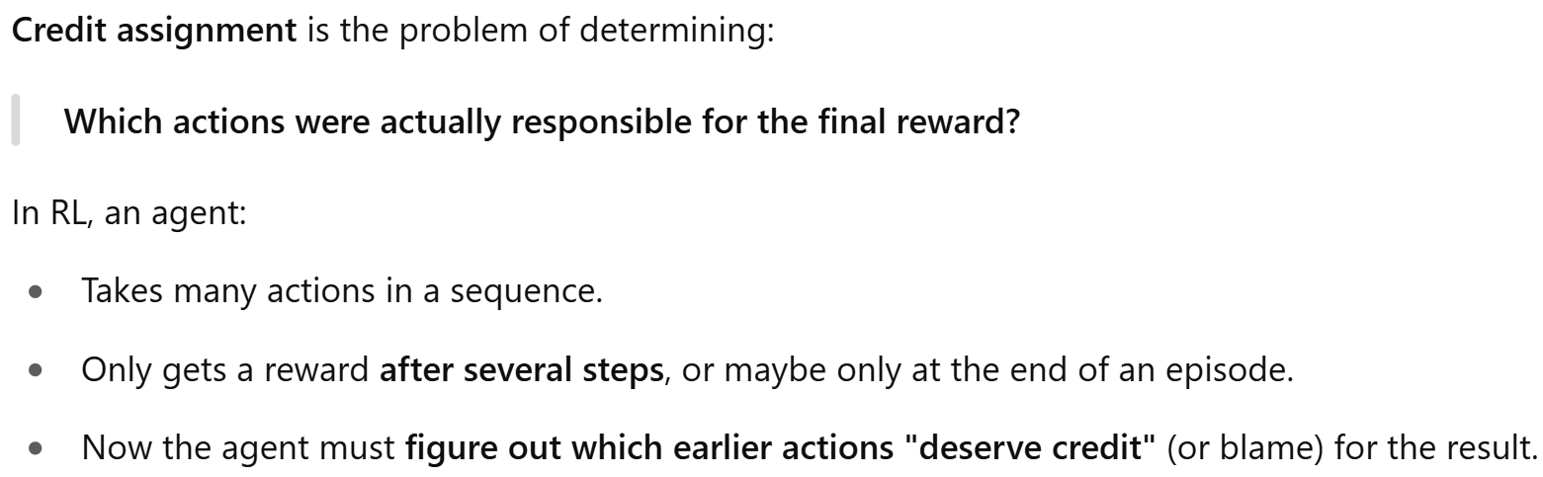
What is Credit Assignment?

Slide 13
Why is Credit Assignment Hard?
1. Delayed Rewards
The agent may only receive a reward at the end of an episode — but many actions occurred before that. Which action(s) led to that good/bad outcome?
Example: A robot arm stacking blocks gets a reward only if it finishes the stack successfully. But which of the 100 movements actually caused success or failure?
2. Stochasticity
The environment might be random — even if the same action is taken, the result could differ. So it’s hard to know if an action was actually helpful or just lucky.

Slide 14
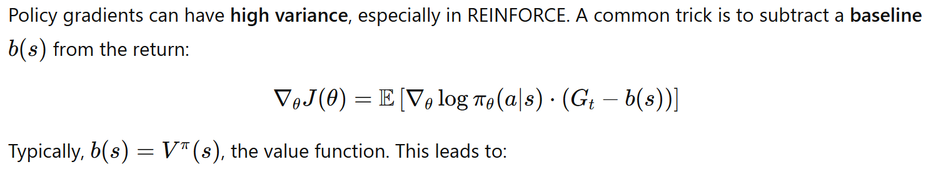
Variance Reduction: Baselines

Slide 15
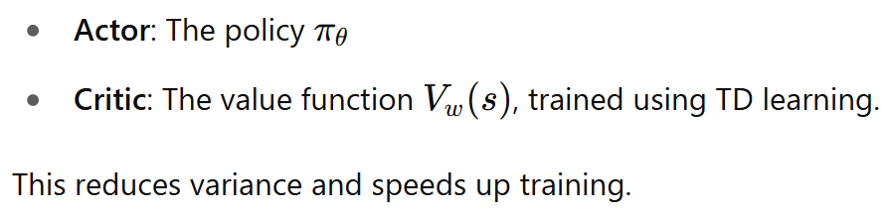
Actor-Critic Methods:

Slide 16
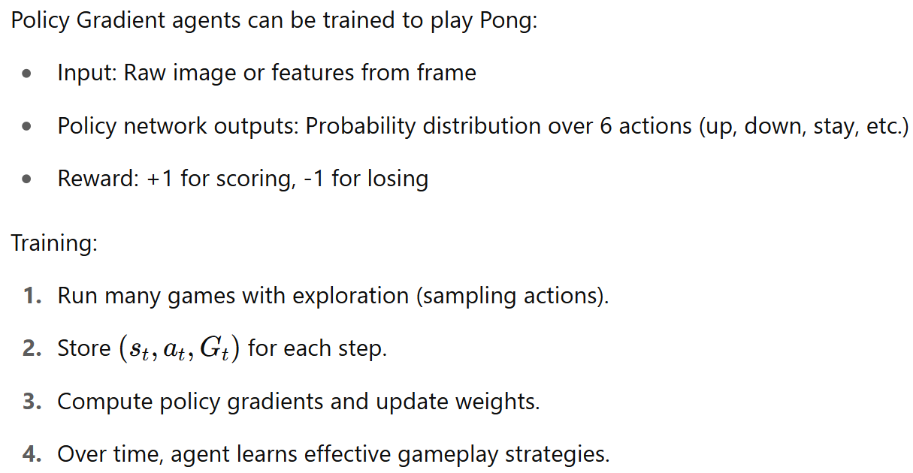
Example: Game Playing – Pong (Atari)

Slide 17
What is the Recurrent Attention Model (RAM)?
The Recurrent Attention Model, introduced by Mnih et al. (2014), is a neural architecture that learns where to look in an image before making a prediction.
Instead of processing the entire image, RAM:
Looks at small glimpses (patches) at different locations.
Decides where to look next based on what it has seen.
Uses a recurrent network to accumulate information.
Outputs a classification or decision at the end.
The attention locations are stochastic and non-differentiable, so they must be trained using REINFORCE.

Slide 18
Why RAM Uses REINFORCE
The attention mechanism in RAM:
Samples a location lt to attend to at each time step.
Since sampling is not differentiable, we can’t use backpropagation to learn the attention policy directly.
So instead, we use:
REINFORCE to train the attention policy — treating it like an RL agent choosing actions (where to look) to maximize reward (accuracy).

